Slide 1


3D Scanner
Presented by Meldrick REIMMER
Danie SONIZARA
Selma BOUDISSA
Jaafer Al-TUWAYYIJ
Supervised by Cansen Jiang and David Strubel

Slide 2
Outline
Introduction
Literature review
Objectives
System Design
Implementation
Proposed improvements
Conclusion
Demo

Slide 3
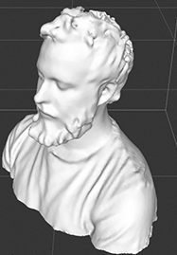
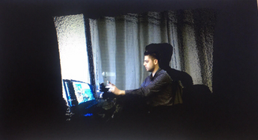
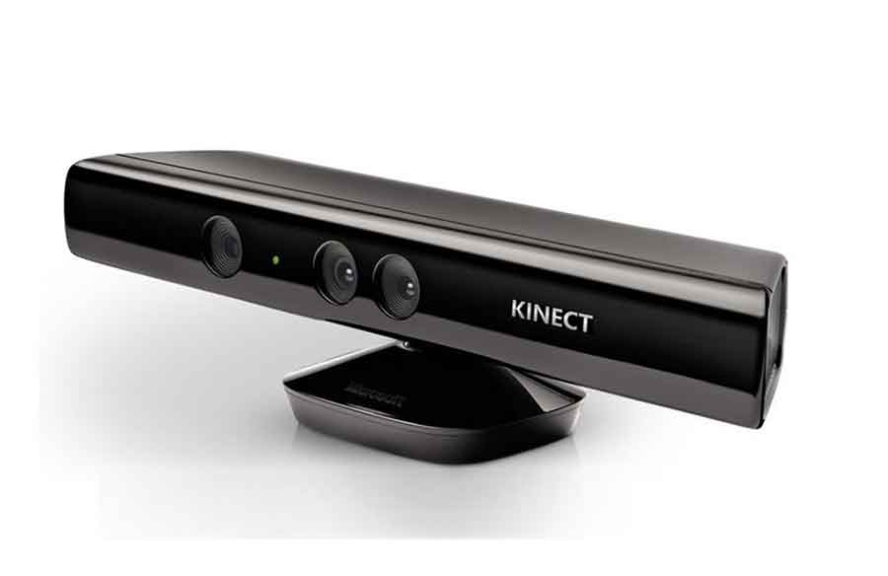
Introduction
1

Slide 4

Literature review
3D-Korn
2

Slide 5
Objectives
Run the 3D-Korn
Propose improvements
Show results
3

Slide 6
Designs
V Model
Flow Chart
Use Case Diagram
4

Slide 7
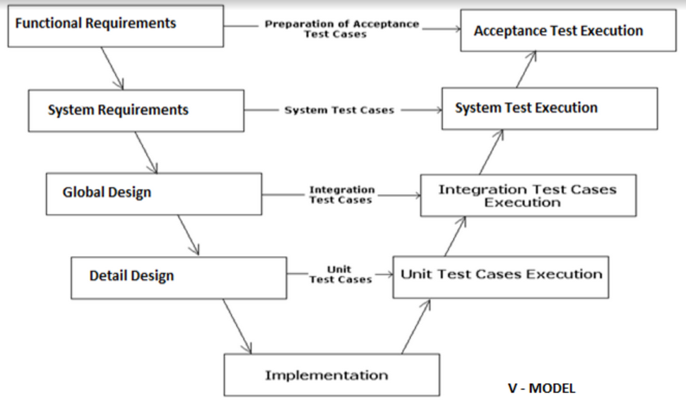
V Model
5

Slide 8
Flow Chart
START
Scan
Point Cloud
YES
NO
Save
3D Mesh
Scan Again
YES
NO
Results
END
6

Slide 9
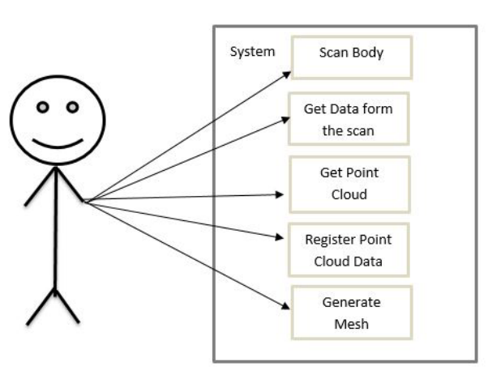
Use Case Diagram
7

Slide 10
Implementation
Scanning
Point Cloud Acquisition / Registration
3D Reconstruction
8

Slide 11
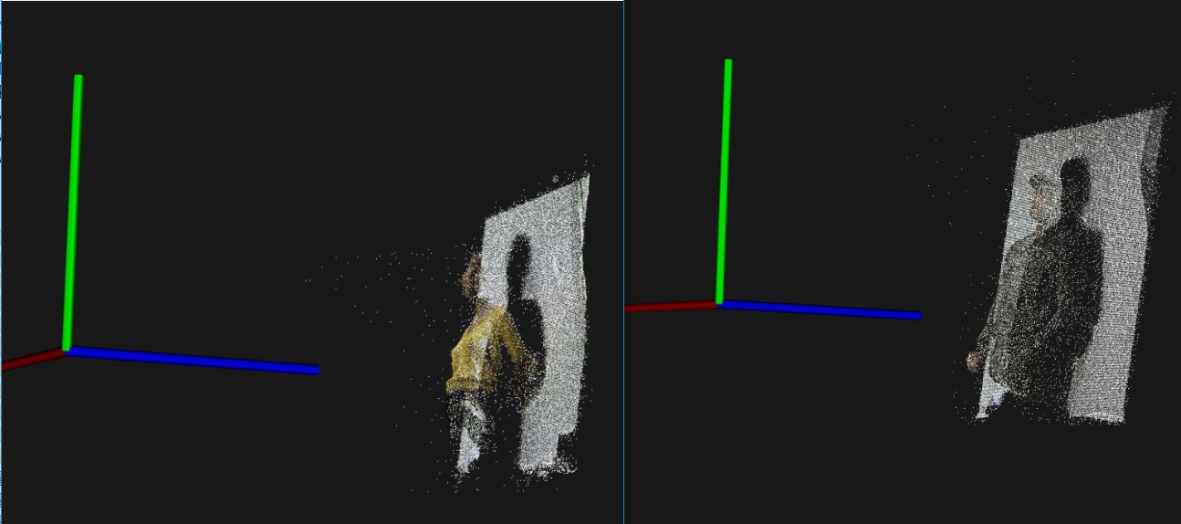
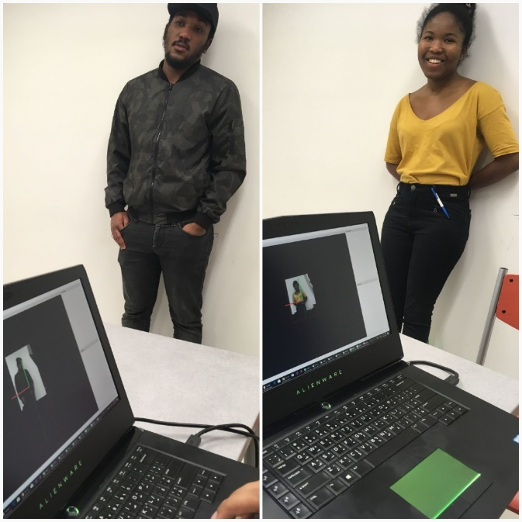
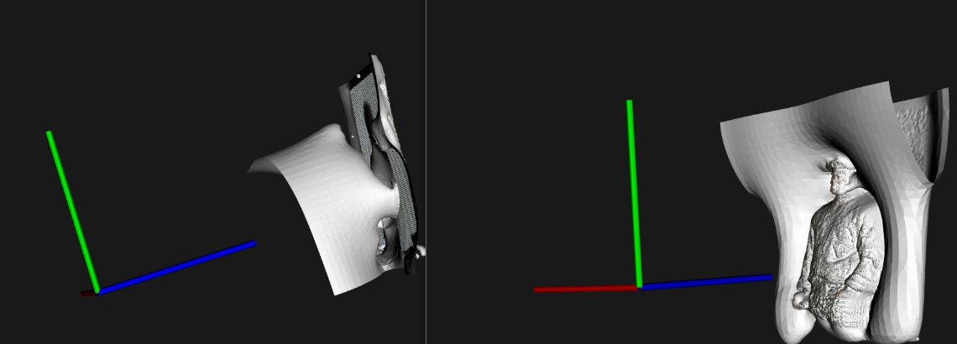
Scanning
Point Cloud Acquisition / Registration
3D Reconstruction
9

Slide 12
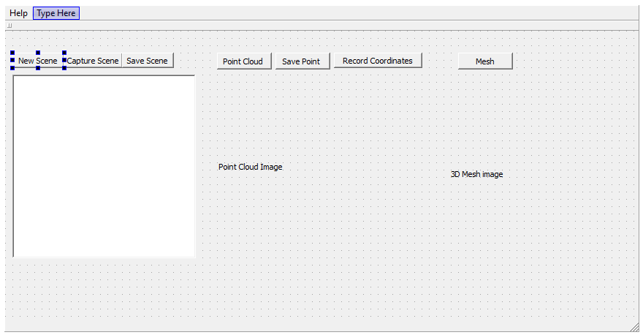
Proposed Improvements
10

Slide 13
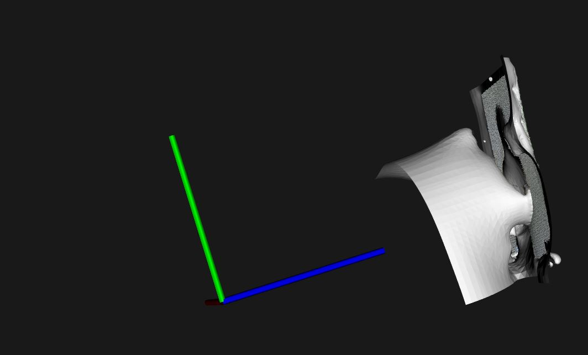
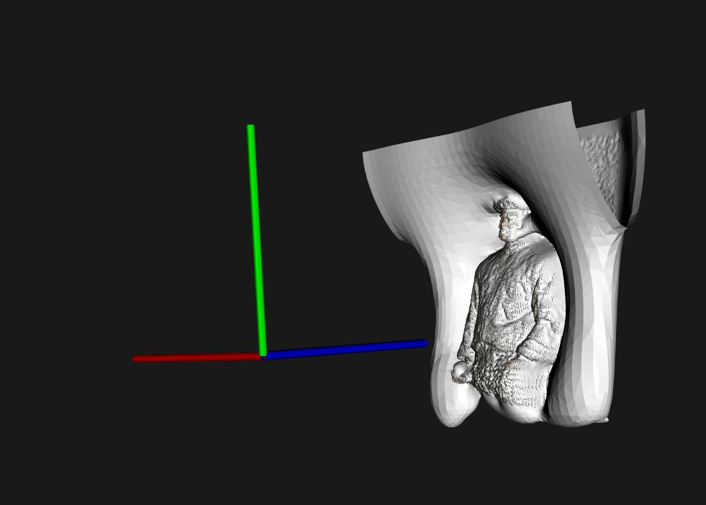
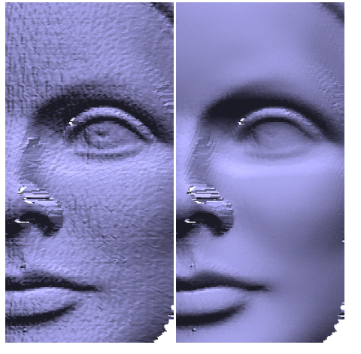
Proposed Improvements
11

Slide 14
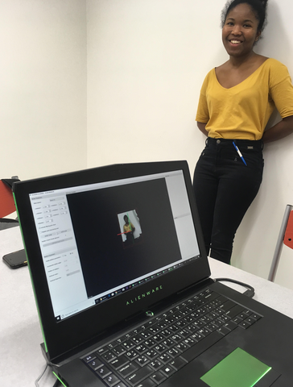
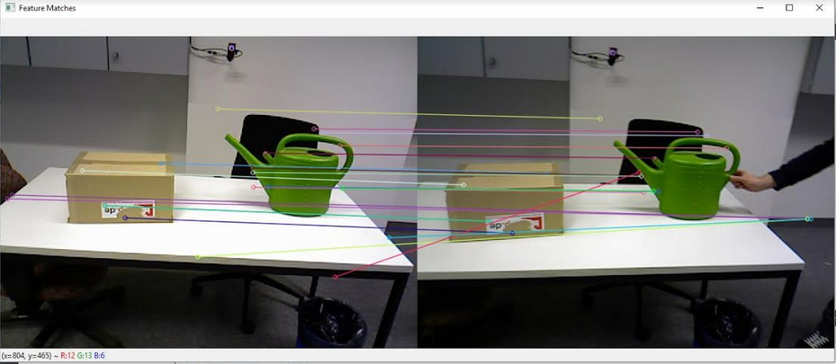
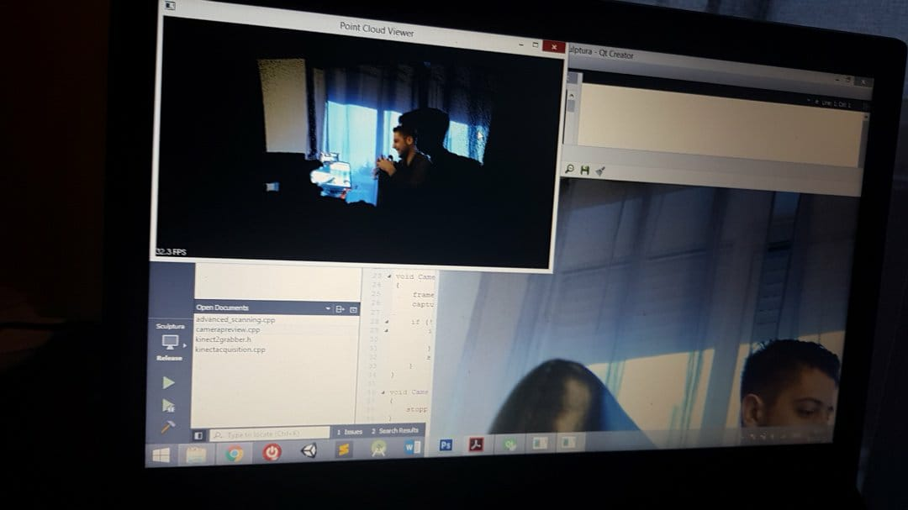
Conclusion & Perspectives
12

Slide 15
Demo
13

Slide 16
Sources
Trello acount:
https://trello.com/b/MaBdGQ7p/software-engineering
GitHub:
https://github.com/MSCV1-2017/3D-ScannerProject
https://github.com/umaatgithub/3D-KORN

